Slide 1
Latent factor model & Learning algorithm
2013-5-30
Seung-hwan baek

Slide 2
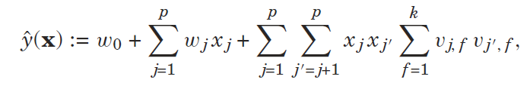



FM model
factorize Matrix V: use non-direct information
Lemma: $W=VV^{T} if k is chosen large enough$

Slide 3
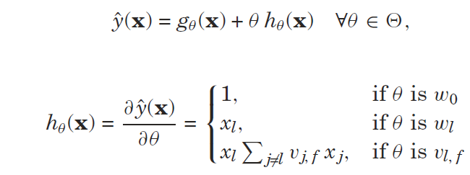
Learning
Gradient of predicted value

Slide 4



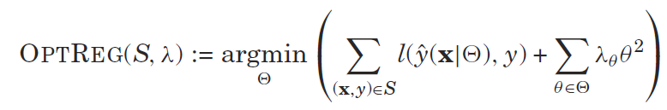
Object-Optimization
Minimize the gap between true value and predicted value
Loss function
Regression
Least square loss
Binary Classification
Sigmoid/logistic function
To avoid overfitting
Regularization value per group

Slide 5
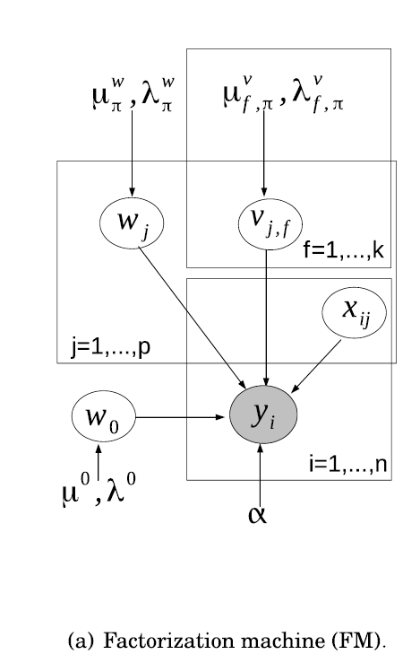


Probabilistic interpretation
Regression
Binary classification
b: link function like logistic function

Slide 6


Gradients
Loss function of gradient
Regression
Binary classification

Slide 7
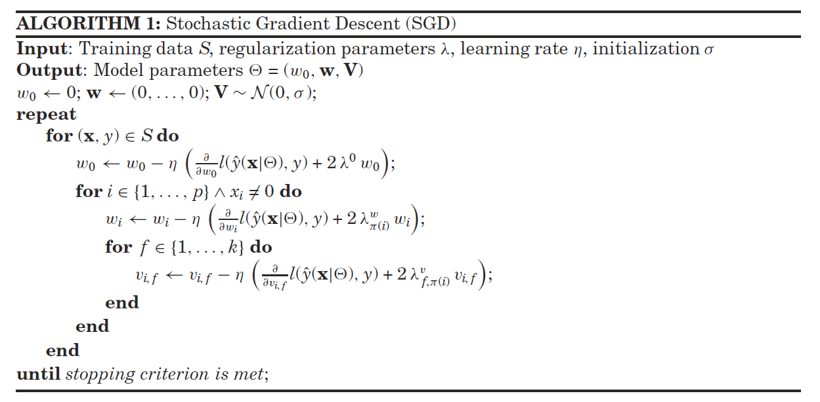
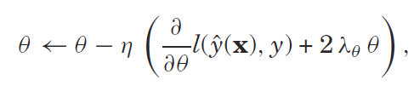

Stochastic Gradient Descent(SGD)
Object: Find Loss function’s global minimum, but we can’t
At least local minimum
Iterates over $(x,y)$ in S

Slide 8



SGD hyperparameters

Slide 9
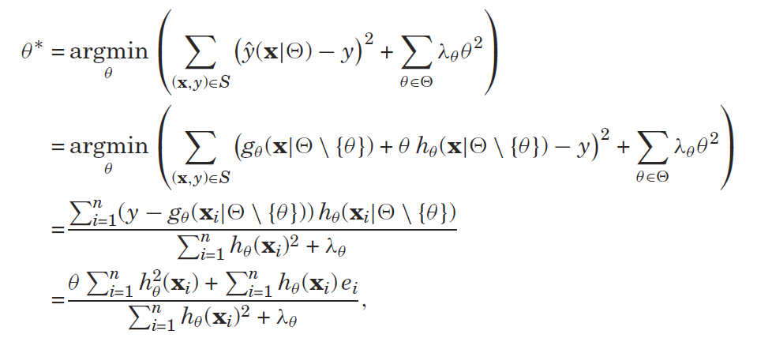

Alternating Least-Squares/Coordinate Descent
SGD: Minimizing the loss per training data
ALS: Minimizing the loss per model parameter

Slide 10
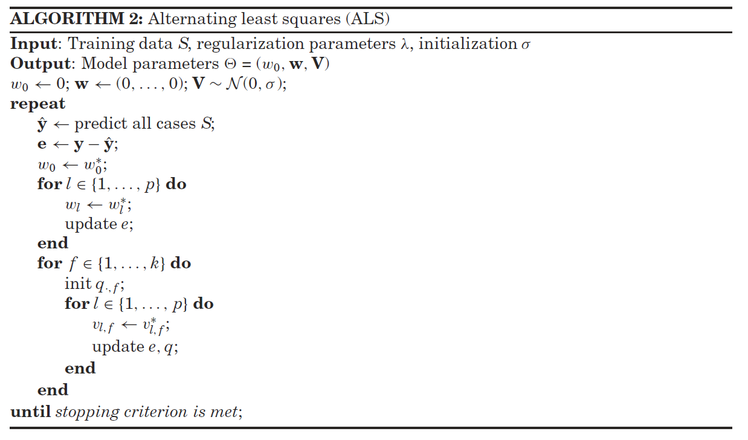

ALS hyperparametsers

